Slide 1
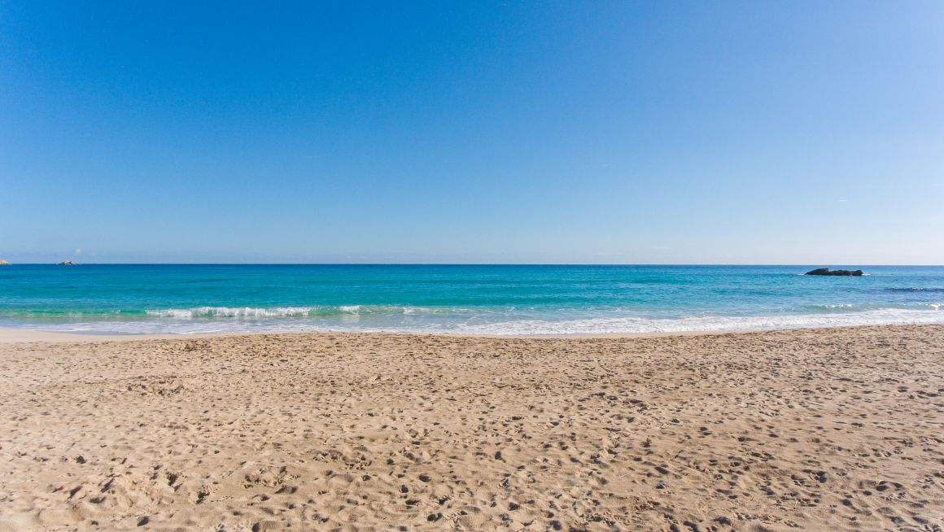
Event Funding

Slide 2
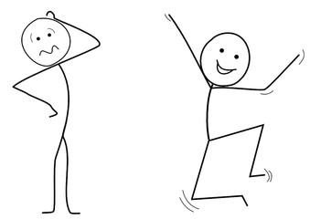
Meet Rüdiger and his friends
Notes:
A while ago, Rüdiger planned a vacation with his three friends. He rented a villa directly by the sea, which was quite expensive for Rüdiger, but as he thought his friends would pay their share he could afford it. Unluckily for Rüdiger one of his friends had made on short notice different plans and didn‘t show up. Another friend took over two months time after the vacation until he finally paid his share. So even tough Rüdiger had great fun on this vacation, he was sad about the financial distress caused by one friend not showing up, and one friend paying his share late.

Slide 3
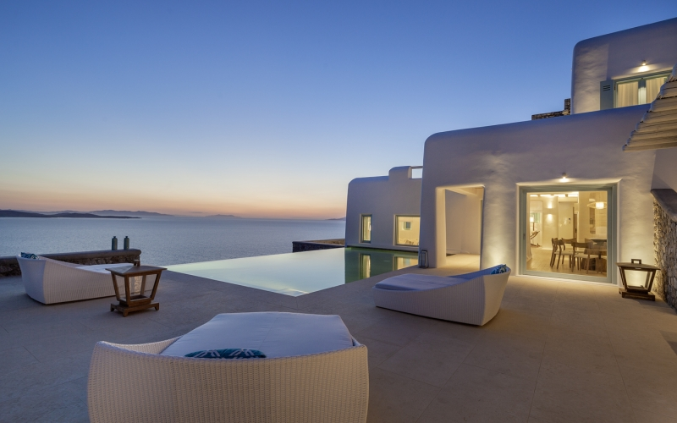

Slide 4
Sad Rüdiger
Notes:
Rüdiger came to us and asked us for help. Therefor we created a smartcontract , which prevents the problem of attendees not showing up and also not paying their share, or waiting a long time for the payment. A smartcontract which allows Rüdiger to continue to make such events or vacations without financial problems

